Slide 1
Unit 3
The Geometry of Multiple Views:
Stereopsis:
Segmentation by Clustering:

Slide 2
Outline
The Geometry of Multiple Views:Two Views,
Stereopsis:
Reconstruction, Human Stereposis, Binocular Fusion, Using More Cameras,
Segmentation by Clustering:
What Is Segmentation?,
Human Vision: Grouping and Getstalt,
Applications: Shot Boundary Detection and Background Subtraction,
Image Segmentation by Clustering Pixels,
Segmentation by Graph-Theoretic Clustering,

Slide 3
The Geometry of Multiple Views:
Despite the wealth of information contained in a photograph, the depth of a scene point along the corresponding projection ray is not directly accessible in a single image.
With at least two pictures, on the other hand, depth can be measured through triangulation.
In particular, we will elucidate the geometric and algebraic constraints that hold among two, three, or more views of the same scene.

Slide 4
In the familiar setting of binocular stereo vision, we will show that the first image of any point must lie in the plane formed by its second image and the optical centers of the two cameras.
This epipolar constraint can be represented algebraically by a 3×3 matrix called the essential matrix when the intrinsic parameters of the cameras are known, and the fundamental matrix otherwise.
Three pictures of the same line will introduce a different constraint, namely that the intersection of the planes formed by their preimages be degenerate.

Slide 5
Algebraically, this geometric relationship can be represented by a 3 × 3 × 3 trifocal tensor.
More images will introduce additional constraints, for example four projections of the same point will satisfy certain quadrilinear relations whose coefficients are captured by the quadrifocal tensor, etc.

Slide 6
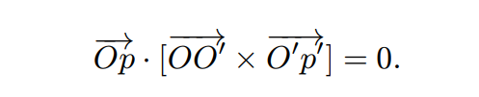
Two Views
Epipolar Geometry
Epipolar geometry is the geometry of stereo vision. When two cameras view a 3D scene from two distinct positions, there are a number of geometric relations between the 3D points and their projections onto the 2D images that lead to constraints between the image points
The Calibrated Case
Camera calibration is the process of determining specific camera parameters in order to complete operations with specified performance measurements.
The Uncalibrated Case
Weak Calibration

Slide 7
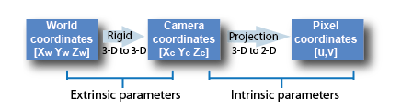
The Calibrated Case
1. Intrinsic or Internal Parameters
It allows mapping between pixel coordinates and camera coordinates in the image frame. E.g. optical center, focal length, and radial distortion coefficients of the lens.
2. Extrinsic or External Parameters
It describes the orientation and location of the camera. This refers to the rotation and translation of the camera with respect to some world coordinate system.

Slide 8
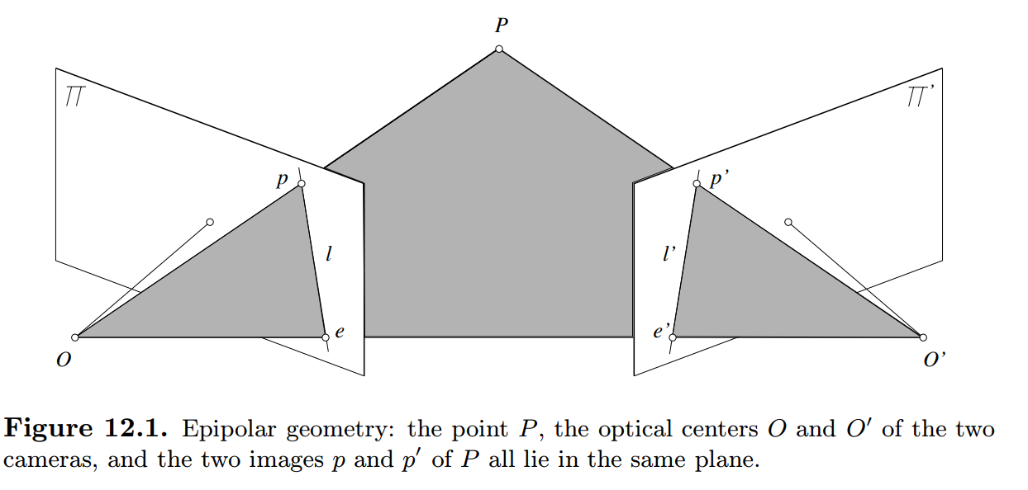
Epipolar Geometry

Slide 9
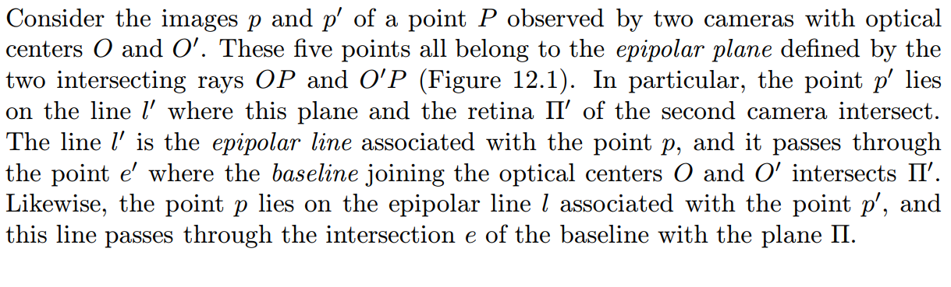
Contd..

Slide 10
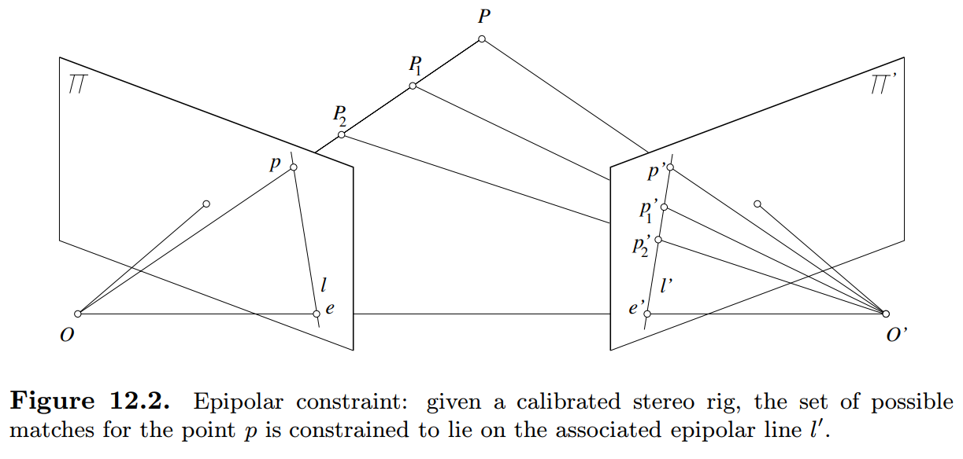
Epipolar Constraint

Slide 11
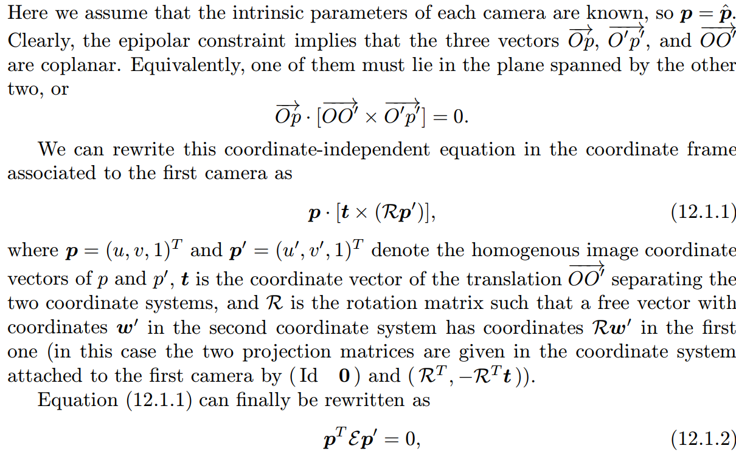
The Calibrated Case

Slide 12
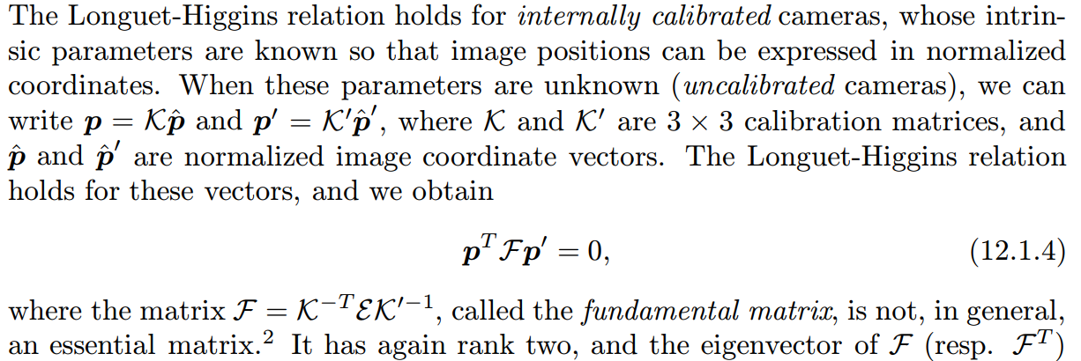
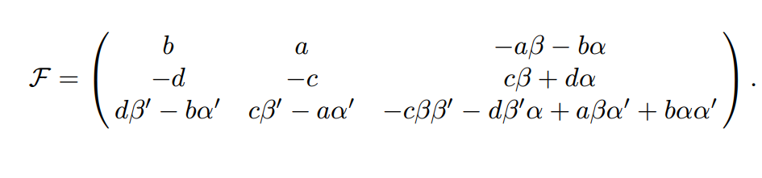
The Uncalibrated Case

Slide 13
Small Motions
Let us now turn our attention to infinitesimal displacements. We consider a moving camera with translational velocity v and rotational velocity ω and rewrite (12.1.2) for two frames separated by a small time interval δt. Let us denote by p˙ = (˙u, v,˙ 0)T the velocity of the point p, or motion field.

Slide 14
Weak Callibration
The simpler problem of estimating the epipolar geometry from a redundant set of point correspondences between two images taken by cameras with unknown intrinsic parameters, a process known as weak calibration.

Slide 15
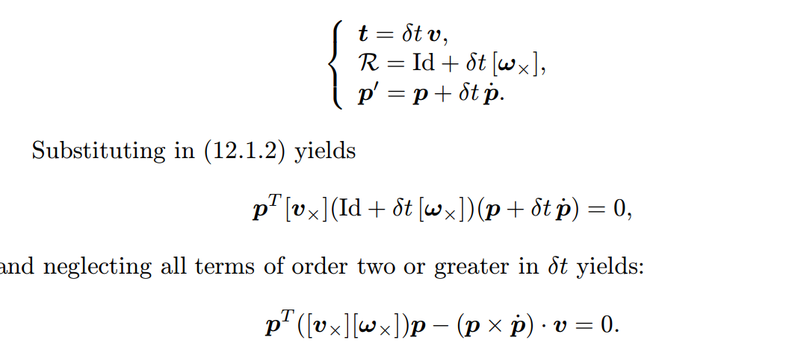

Slide 16
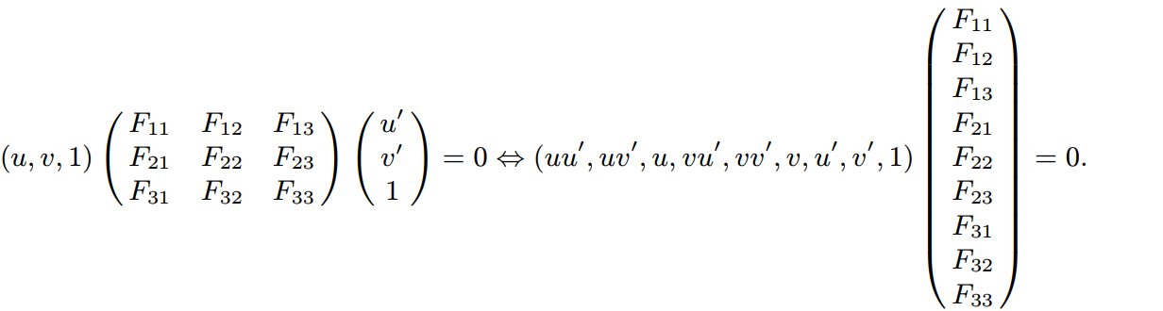
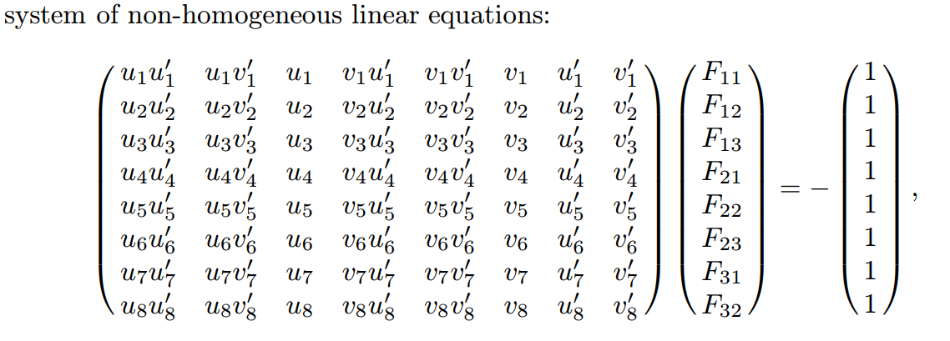

Slide 17
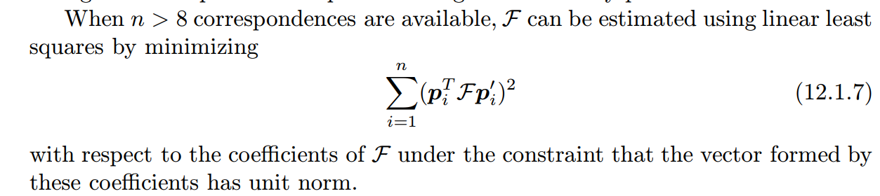

Slide 18
Stereopsis
Reconstruction
Human Stereposis
Binocular Fusion
Using More Cameras

Slide 19
Fusing the pictures recorded by our two eyes and exploiting the difference (or disparity) between them allows us to gain a strong sense of depth is known as Stereopsis.
Stereo vision involves two processes: the binocular fusion of features observed by the two eyes, and the reconstruction of their three-dimensional preimage.

Slide 20
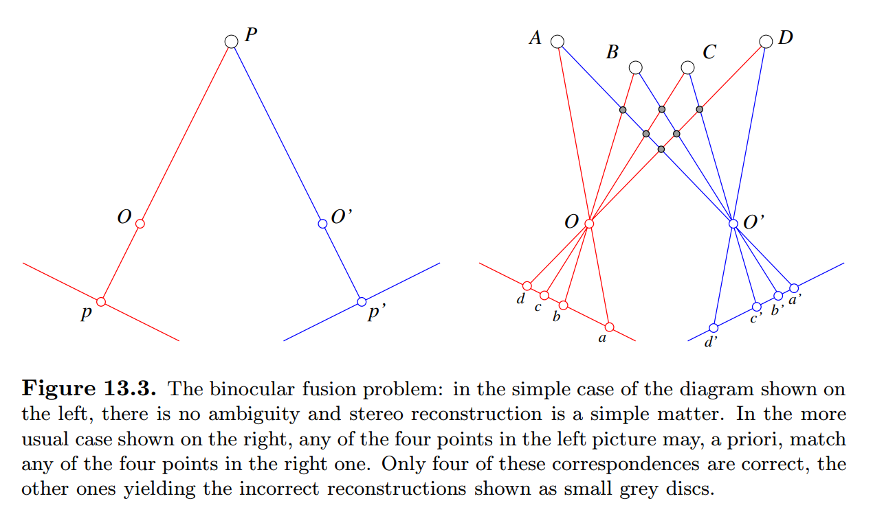

Slide 21
Reconstruction
Given a calibrated stereo rig and two matching image points p and p , it is in principle straightforward to reconstruct the corresponding scene point by intersecting the two rays R = Op and R = O p . However, the rays R and R will never, in practice, actually intersect, due to calibration and feature localization errors

Slide 22
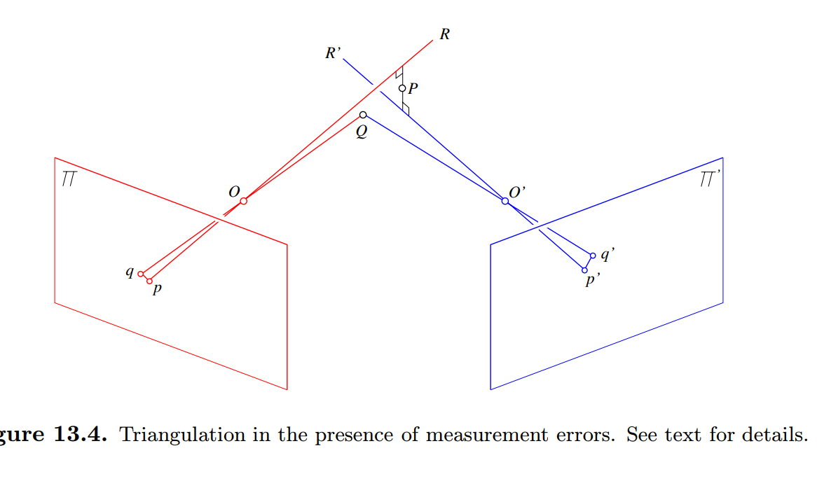

Slide 23
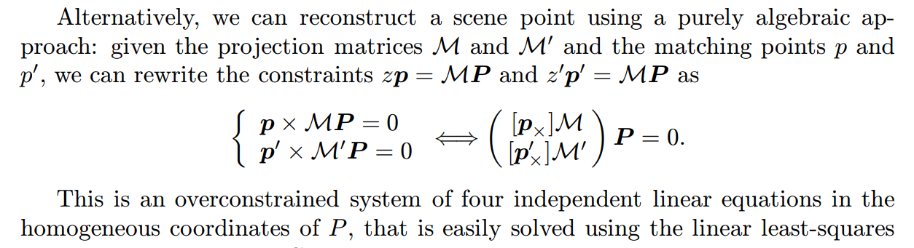

Slide 24
Camera Calibrati
It should also be noted that, once the intrinsic and extrinsic camera parameters are known, it is a simple matter to estimate the multi-view geometry (essential matrix for two views, trifocal tensor for three, etc.) on

Slide 25
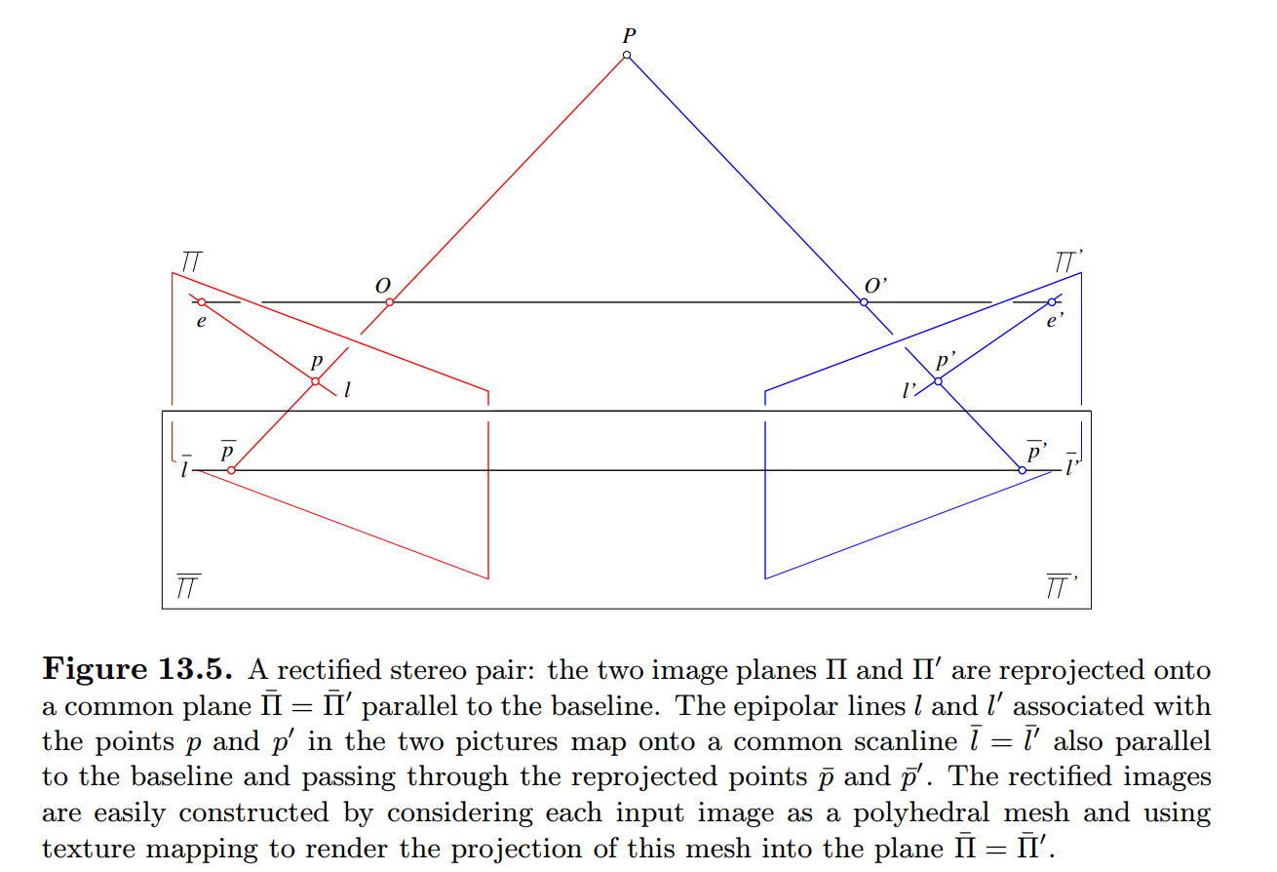
Image Rectification

Slide 26
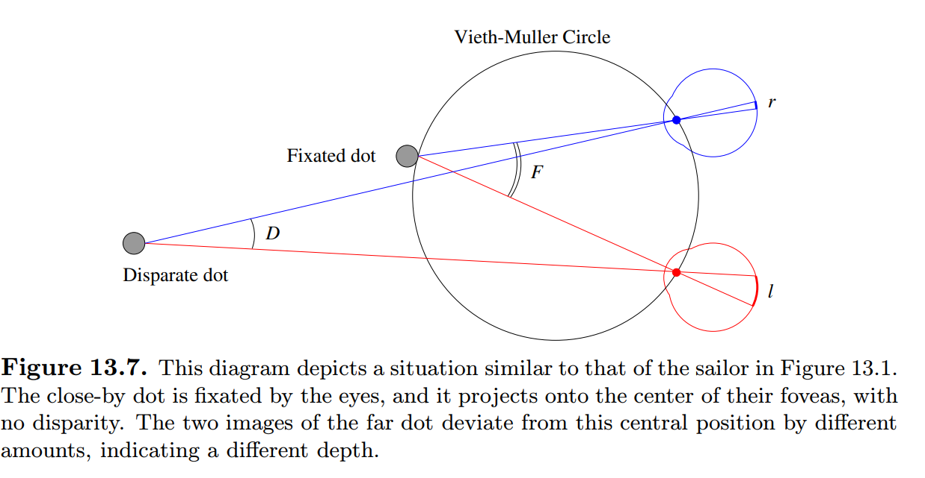
Human Stereposis

Slide 27
If l and r denote the (counterclockwise) angles between the vertical planes of symmetry of two eyes and two rays passing through the same scene point, we define the corresponding disparity as d = r − l (Figure 13.7). It is an elementary exercise in trigonometry to show that d = D −F, where D denotes the angle between these rays, and F is the angle between the two rays passing through the fixated point. Points with zero disparity lie on the ViethM¨uller circle that passes through the fixated point and the anterior nodal points of the eyes.
Points lying inside this circle have a positive (or convergent) disparity, points lying outside it have, as in Figure 13.7, a negative (or divergent) disparity,3 and the locus of all points having a given disparity d forms, as d varies, the pencil of all circles passing through the two eyes’ nodal points.

Slide 28
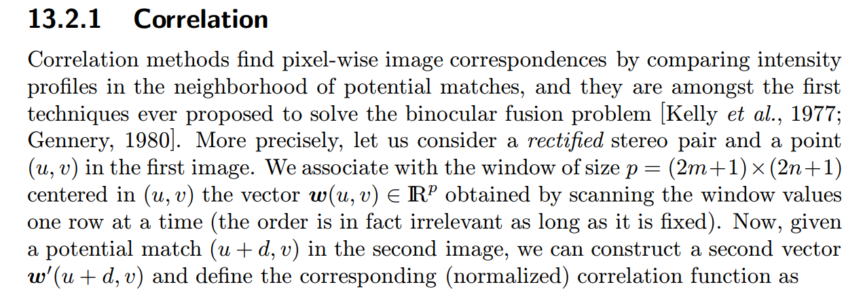
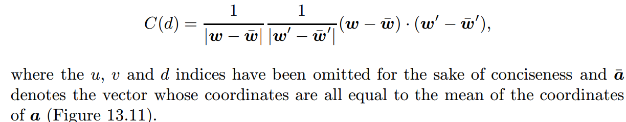
Binocular Fusion

Slide 29
Although human binocular fusion is effortless and reliabe in most situations, we can be fooled too: the abstract single-image stereograms that were popular in the late nineties demonstrate this quite well: in this case, repetitive patterns or judiciously assembled random dots are used to trick the eyes into focussing on the wrong correspondences, producing a vivid impression of layered planes.2 This suggests that constructing a reliable stereo vision program is difficult

Slide 30
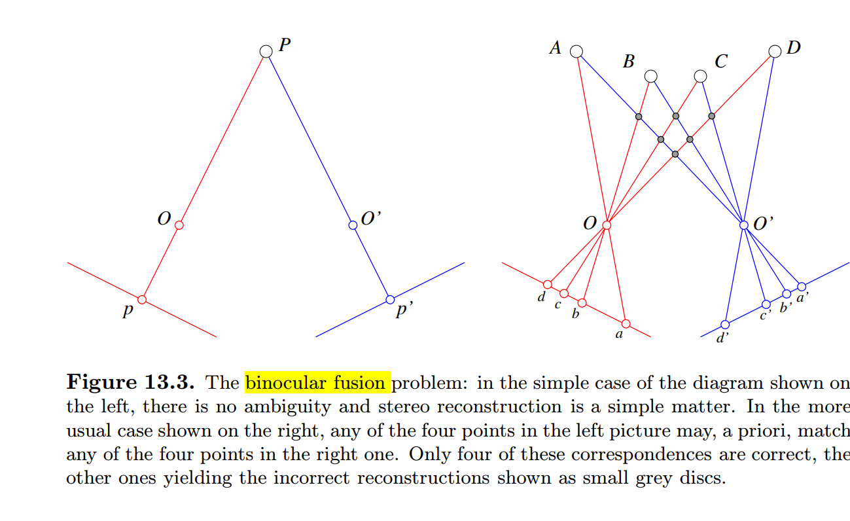

Slide 31
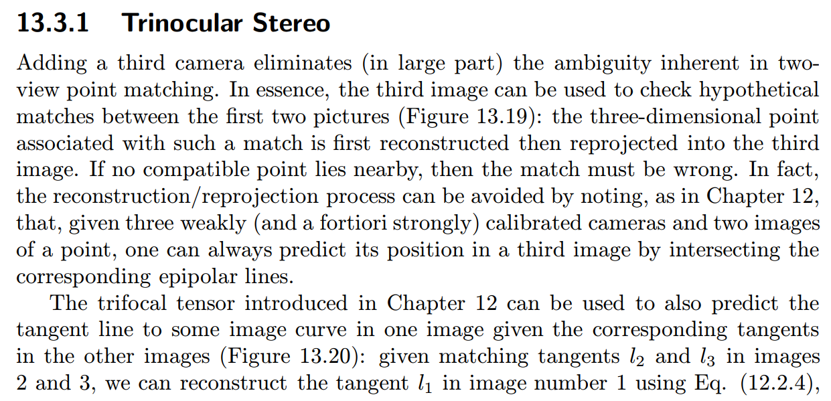
Using More Cameras

Slide 32
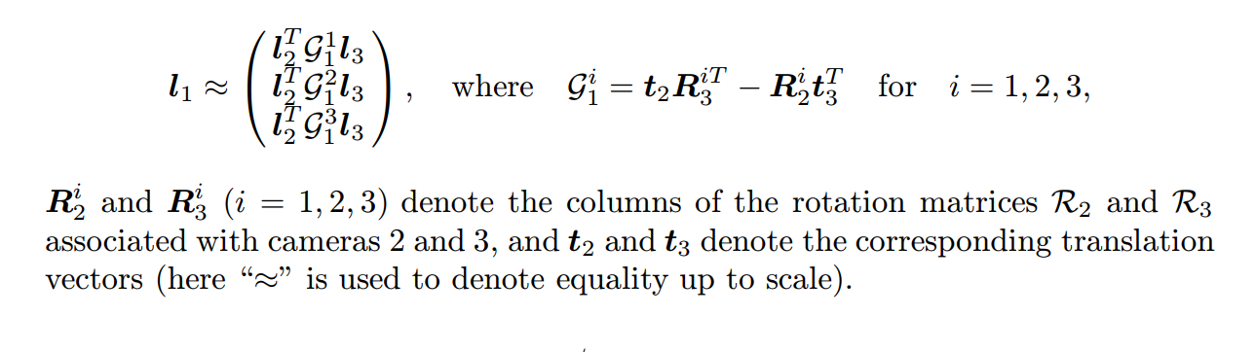

Slide 33
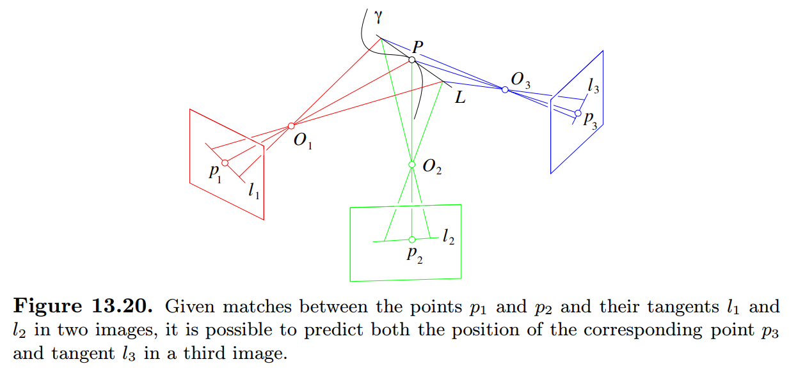

Slide 34
Segmentation by Clustering:
What Is Segmentation?,
Human Vision: Grouping and Getstalt,
Applications: Shot Boundary Detection and Background Subtraction,
Image Segmentation by Clustering Pixels,
Segmentation by Graph-Theoretic Clustering

Slide 35
What Is Segmentation?,
“A compact representation of the “interesting” image data that emphasizes the properties that make it “interesting”. Obtaining such representation is known variously as segmentation, grouping, perceptual organisation or fitting.”
Firstly, there should be relatively few components in the representation computed for “typical” pictures.
Secondly, these components should be suggestive.

Slide 36
What Is Segmentation?,
It is the process of dividing an image into different regions based on the characteristics of pixels to identify objects or boundaries to simplify an image and more efficiently analyze it.
In digital image processing and computer vision, image segmentation is the process of partitioning a digital image into multiple image segments, also known as image regions or image objects (sets of pixels).
Segmentation impacts a number of domains, from the filmmaking industry to the field of medicine

Slide 37
Methods deal with different kinds of data set: some are intended for images, some are intended for video sequences and some are intended to be applied to tokens — placeholders that indicate the presence of an interesting pattern in an image, say a spot or a dot or an edge point.
Examples.
• Summarizing video:
Finding machined parts:
Finding people:
Finding buildings in satellite images:
Searching a collection of images:

Slide 38
One natural view of segmentation is that we are attempting to determine which components of a data set naturally “belong together”. This is a problem known as clustering.
Partitioning: here we have a large data set, and carve it up according to some notion of the association between items inside the set.

Slide 39
Grouping: here we have a set of distinct data items, and wish to collect sets of data items that “make sense” together according to our model. Effects like occlusion mean that image components that belong to the same object are often separated.
Examples of grouping include:
– collecting together tokens that, taken together, form a line;
– collecting together tokens that seem to share a fundamental matrix

Slide 40
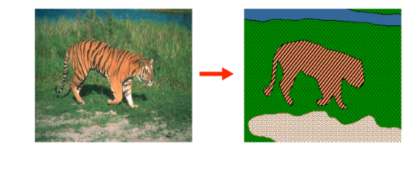

Slide 41
Human Vision: Grouping and Getstalt,
A key feature of the human vision system is that “context” affects how things are perceived.
This observation — which is easily demonstrated experimentally — led the Gestalt school of psychologists to reject the study of responses to stimuli, and to emphasize grouping as the key to understanding visual perception.

Slide 42
grouping meant the tendency of the visual system to assemble some components of a picture together and to perceive them together
A common experience of segmentation is the way that an image can resolve itself into a figure — typically, the significant, important object — and a ground — the background on which the figure lies.

Slide 43
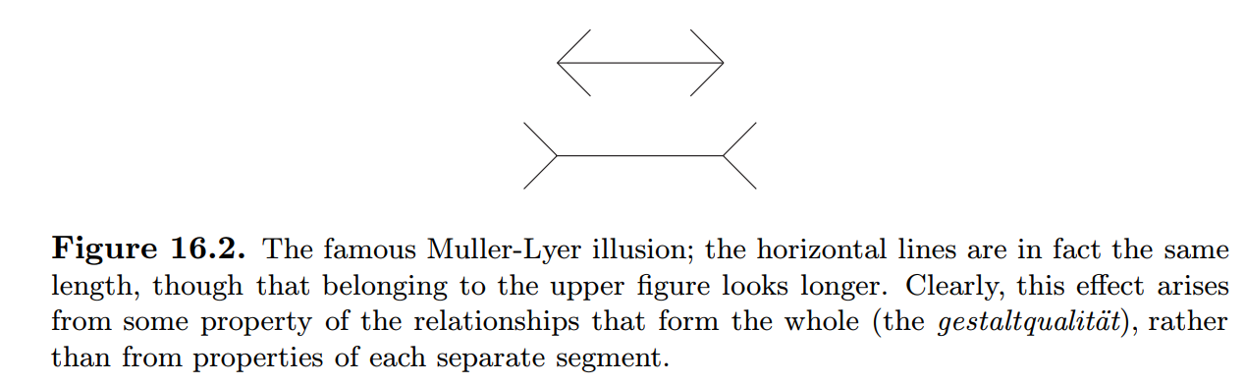

Slide 44
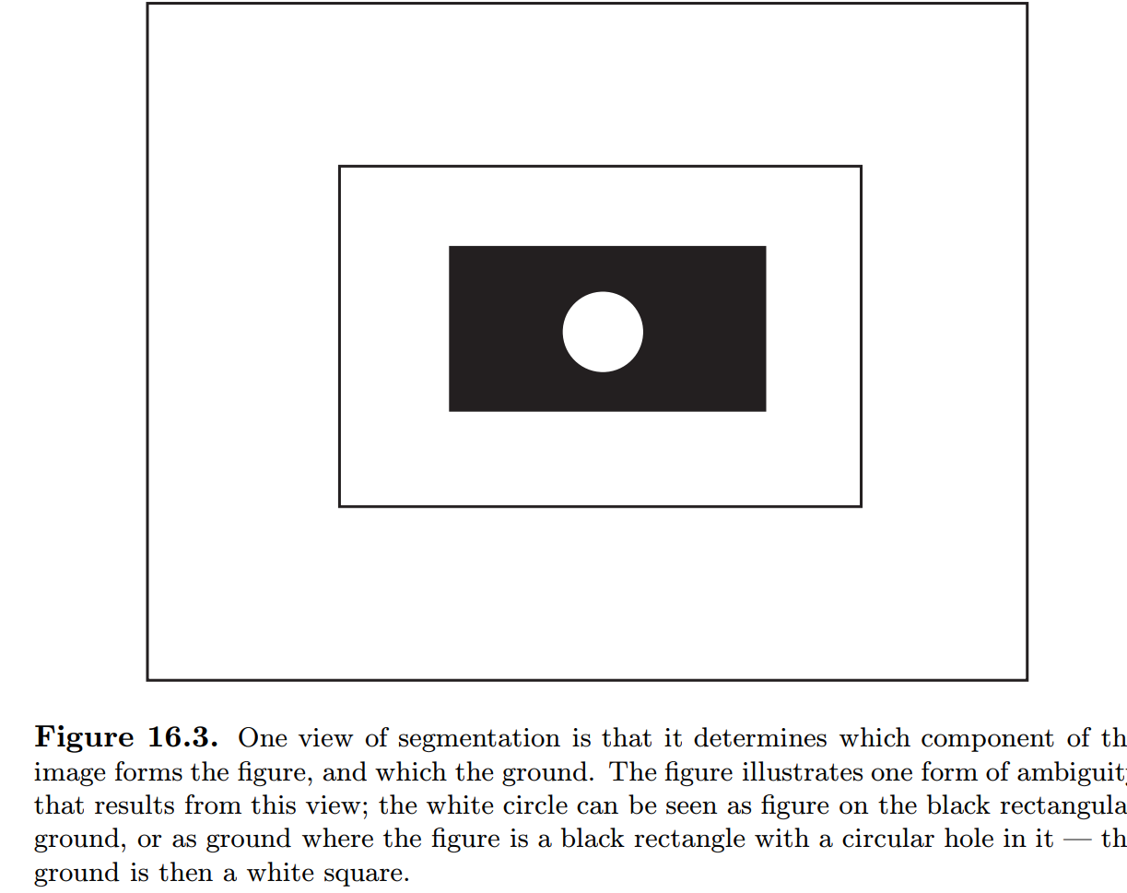

Slide 45
The Gestalt school used the notion of a gestalt — a whole or a group — and of its gestaltqualit¨at — the set of internal relationships that makes it a whole (e.g. figure 16.2) as central components in their ideas.

Slide 46
The Gestalt psychologists identified a series of factors, which they felt predisposed a set of elements to be grouped. These factors are important, because it is quite clear that the human vision system uses them in some way. Furthermore, it is reasonable to expect that they represent a set of preferences about when tokens belong together that lead to a useful intermediate representation

Slide 47
There are a variety of factors, some of which postdate the main Gestalt movement:
• Proximity: tokens that are nearby tend to be grouped.
• Similarity: similar tokens tend to be grouped together.
• Common fate: tokens that have coherent motion tend to be grouped together.
• Common region: tokens that lie inside the same closed region tend to be grouped together.
• Parallelism: parallel curves or tokens tend to be grouped together
• Closure: tokens or curves that tend to lead to closed curves tend to be grouped together.
• Symmetry: curves that lead to symmetric groups are grouped together.
• Continuity: tokens that lead to “continuous” — as in “joining up nicely”, rather than in the formal sense — curves tend to be grouped.
• Familiar Configuration: tokens that, when grouped, lead to a familiar object, tend to be grouped together.

Slide 48
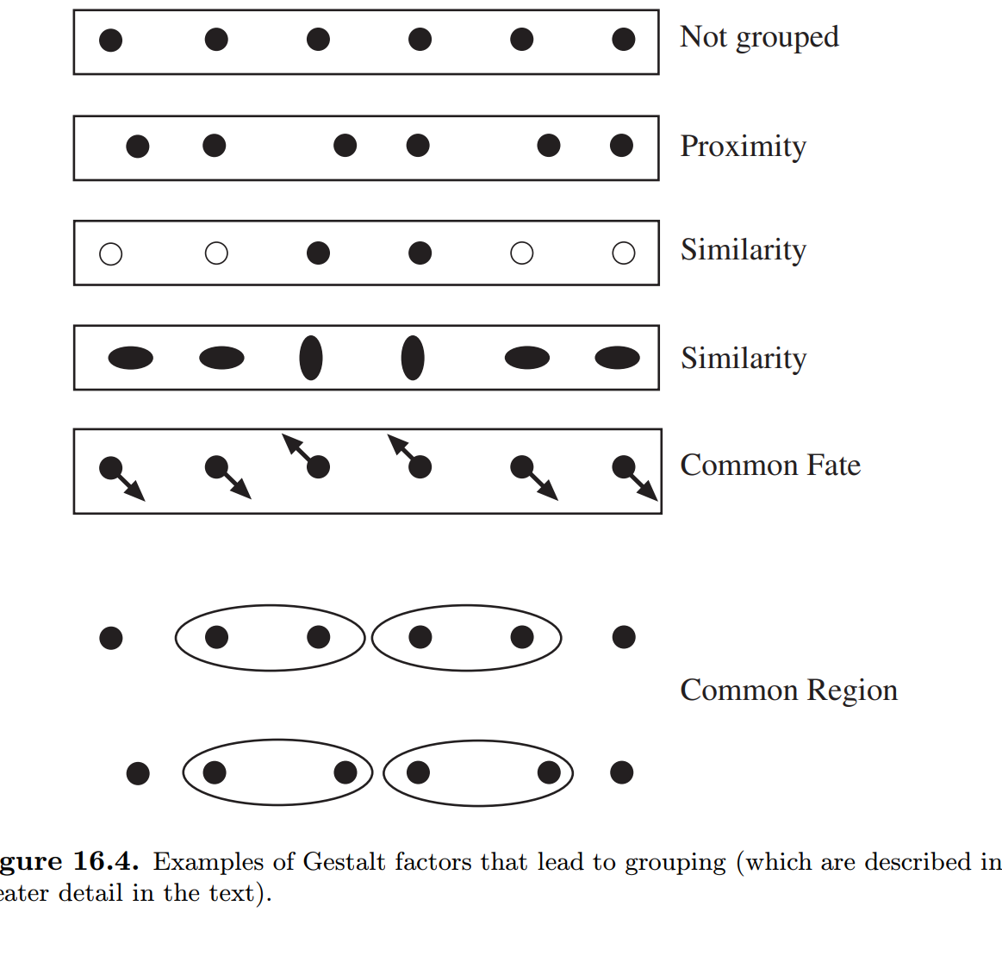

Slide 49
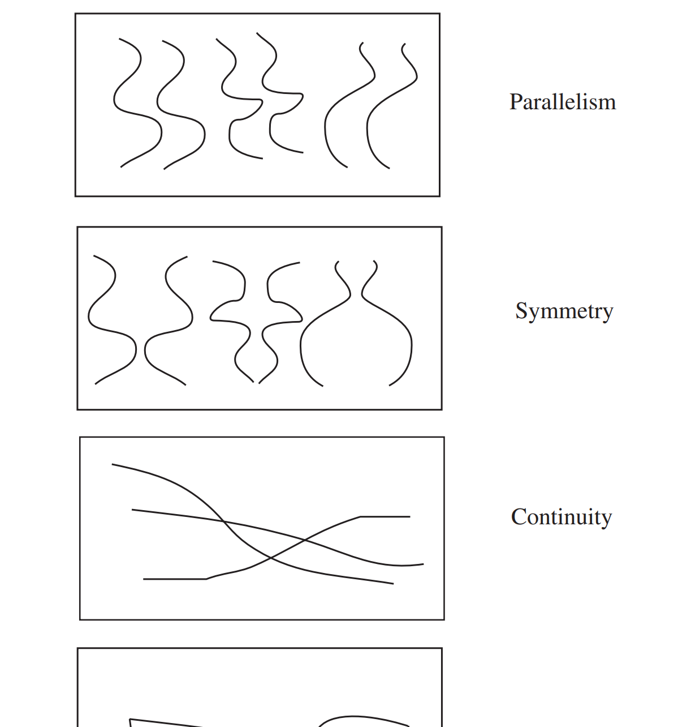

Slide 50
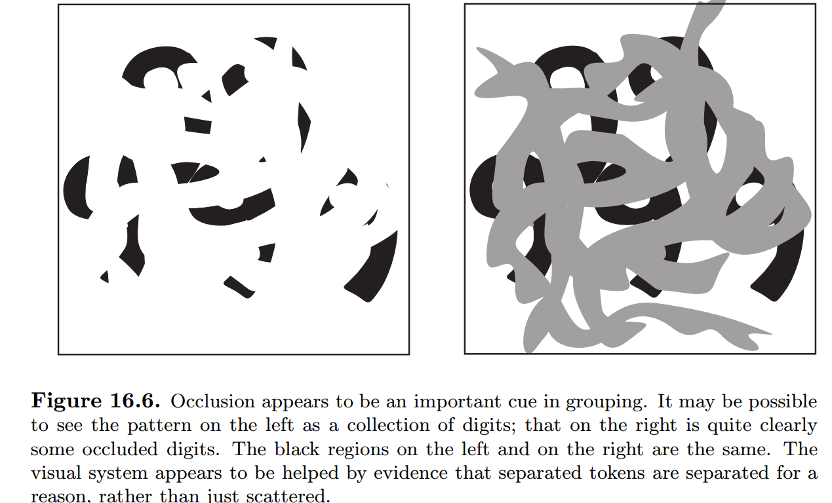
The Gestalt rules do offer some insight, because they offer some explanation for what happens in various examples. These explanations seem to be sensible, because they suggest that the rules help solve problems posed by visual effects that arise commonly in the real world — that is, they are ecologically valid. For example, continuity may represent a solution to problems posed by occlusion — sections of the contour of an occluded object could be joined up by continuity

Slide 51
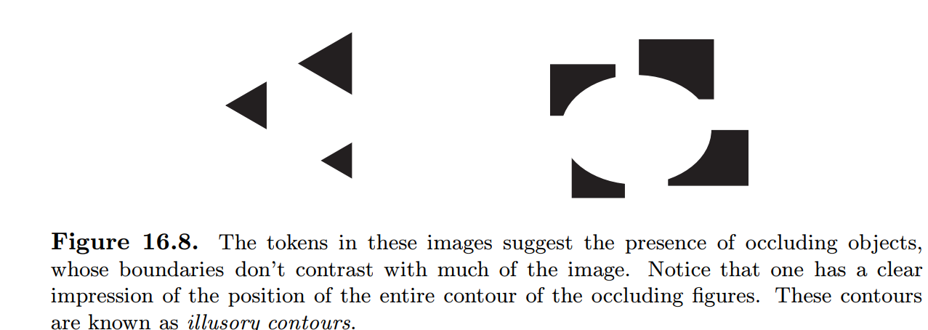
This tendency to prefer interpretations that are explained by occlusion leads to interesting effects. One is the illusory contour, illustrated in figure 16.8. Here a set of tokens suggests the presence of an object most of whose contour has no contrast. The tokens appear to be grouped together because they provide a cue to the presence of an occluding object, which is so strongly suggested by these tokens that one could fill in the no-contrast regions of contour

Slide 52
Applications: Shot Boundary Detection and Background Subtraction,
Simple segmentation algorithms are often very useful in significant applications.
Generally, simple algorithms work best when it is very easy to tell what a “useful” decomposition is.
Three important cases are background subtraction — where anything that doesn’t look like a known background is interesting
— shot boundary detection — where substantial changes in a video are interesting — and skin finding — where pixels that look like human skin are interesting.

Slide 53
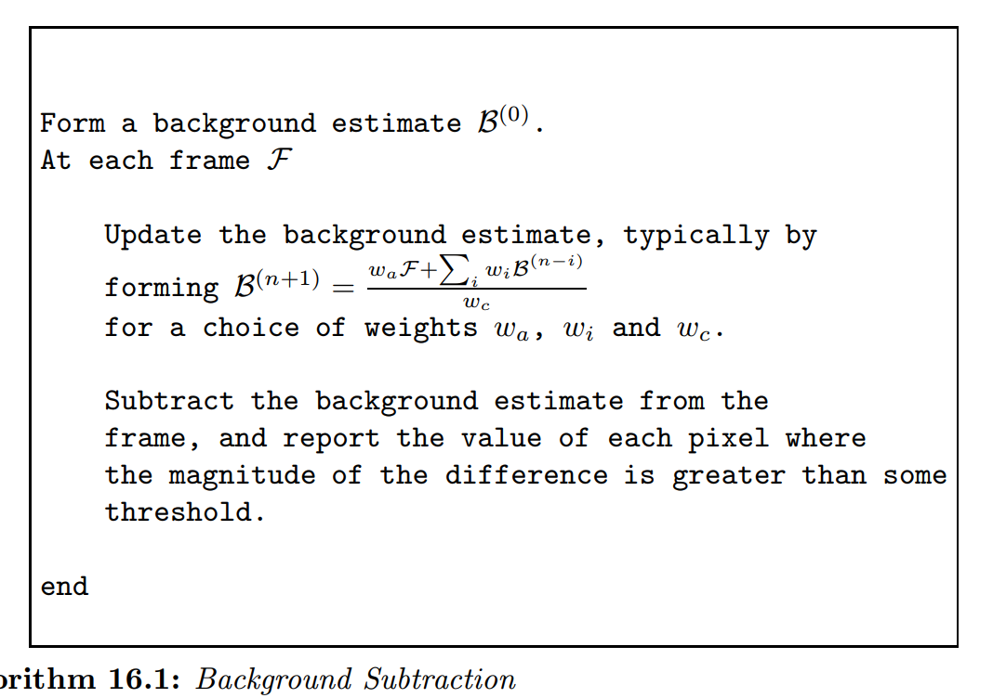

Slide 54
Shot Boundary Detection
Shot Boundary Detection Long sequences of video are composed of shots — much shorter subsequences that show largely the same objects. These shots are typically the product of the editing process.
There is seldom any record of where the boundaries between shots fall. It is helpful to represent a video as a collection of shots; each shot can then be represented with a key frame.
This representation can be used to search for videos or to encapsulate their content for a user to browse a video or a set of videos. Finding the boundaries of these shots automatically — shot boundary detection — is an important practical application of simple segmentation algorithms.

Slide 55
There are a variety of standard techniques for computing a distance:
• Frame differencing algorithms take pixel-by-pixel differences between each two frames in a sequence, and sum the squares of the differences. These algorithms are unpopular, because they are slow — there are many differences — and because they tend to find many shots when the camera is shaking.
• Histogram based algorithms compute colour histograms for each frame, and compute a distance between the histograms. A difference in colour histograms is a sensible measure to use, because it is insensitive to the spatial arrangement of colours in the frame — for example, small camera jitters will not affect the histogram

Slide 56
Block comparison algorithms compare frames by cutting them into a grid of boxes, and comparing the boxes. This is to avoid the difficulty with colour histograms, where (for example) a red object disappearing off-screen in the bottom left corner is equivalent to a red object appearing on screen from the top edge. Typically, these block comparison algorithms compute an inter- frame distance that is a composite — taking the maximum is one natural strategy — of inter-block distances, computed using the methods above

Slide 57
Edge differencing algorithms compute edge maps for each frame, and then compare these edge maps. Typically, the comparison is obtained by counting the number of potentially corresponding edges (nearby, similar orientation, etc.) in the next frame. If there are few potentially corresponding edges, there is a shot boundary. A distance can be obtained by transforming the number of corresponding edges.

Slide 58
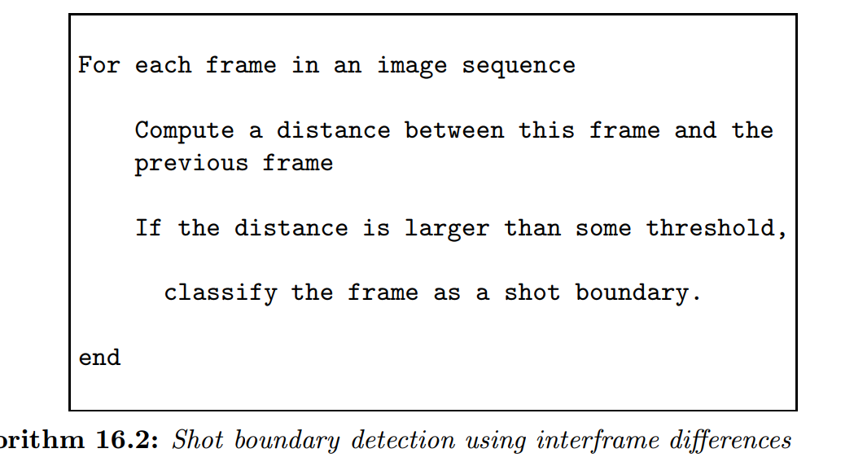

Slide 59
Image Segmentation by Clustering Pixels
Clustering is a process whereby a data set is replaced by clusters, which are collections of data points that “belong together”. It is natural to think of image segmentation as clustering; we would like to represent an image in terms of clusters of pixels that “belong together”. The specific criterion to be used depends on the application. Pixels may belong together because they have the same colour and/or they have the same texture and/or they are nearby, etc.

Slide 60
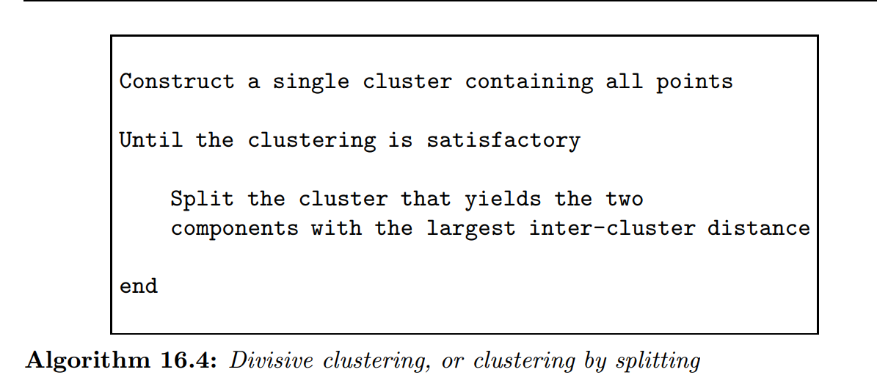
In divisive clustering, the entire data set is regarded as a cluster, and then clusters are recursively split to yield a good clustering

Slide 61
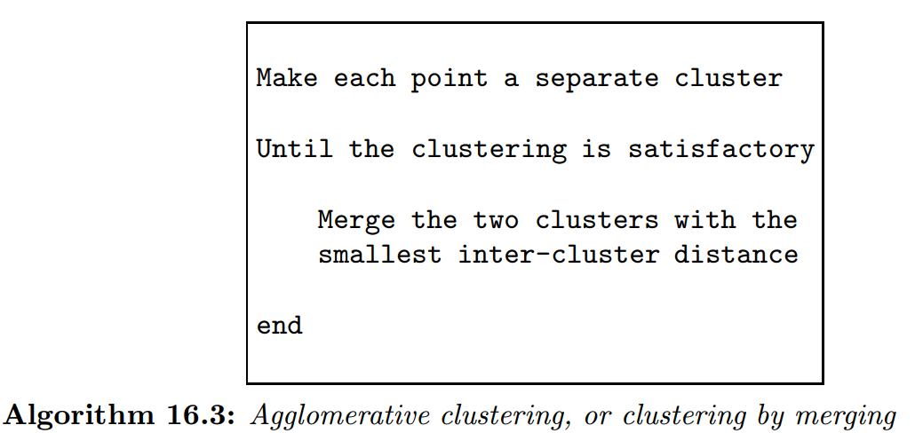
In agglomerative clustering, each data item is regarded as a cluster and clusters are recursively merged to yield a good clustering

Slide 62
dendrogram — a representation of the structure of the hierarchy of clusters that displays inter-cluster distances — and an appropriate choice of clusters is made from the dendrogram

Slide 63
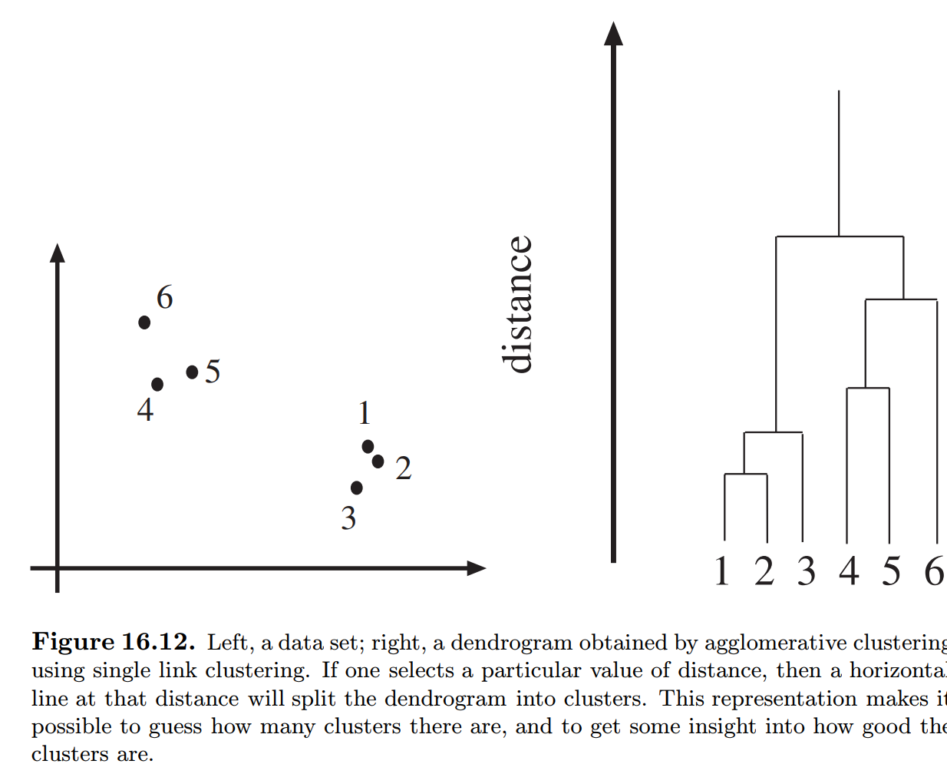

Slide 64
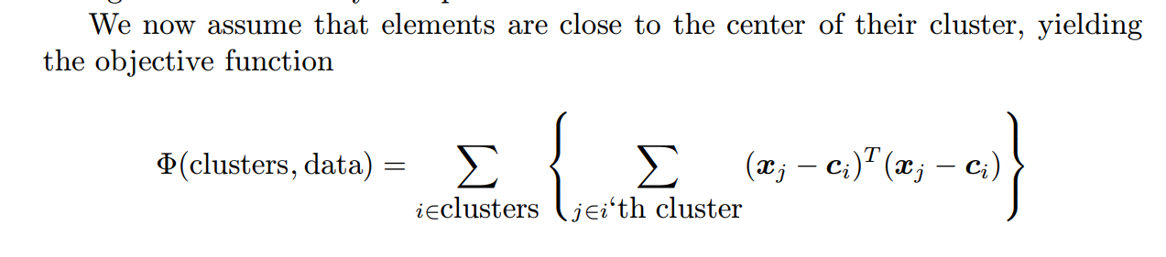
A natural objective function can be obtained by assuming that we know there are k clusters, where k is known. Each cluster is assumed to have a center; we write the center of the i’th cluster as ci. The j’th element to be clustered is described by a feature vector xj . For example, if we were segmenting scattered points, then x would be the coordinates of the points; if we were segmenting an intensity image, x might be the intensity at a pixel.

Slide 65
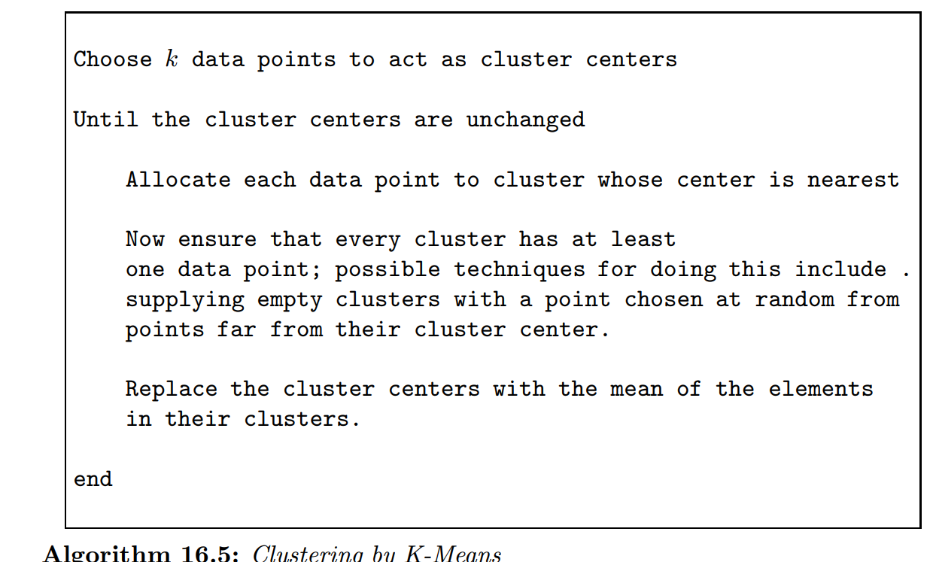

Slide 66
Segmentation by Graph-Theoretic Clustering
Clustering can be seen as a problem of cutting graphs into “good” pieces. In effect, we associate each data item with a vertex in a weighted graph, where the weights on the edges between elements are large if the elements are “similar” and small if they are not. We then attempt to cut the graph into connected components with relatively large interior weights — which correspond to clusters — by cutting edges with relatively low weights. This view leads to a series of different, quite successful, segmentation algorithms.
A graph is a set of vertices V and edges E which connect various pairs of vertices.
A graph can be written G = {V, E}. Each edge can be represented by a pair of vertices, that is E ⊂ V × V . Graphs are often drawn as a set of points with curves connecting the points.
A directed graph is one in which edges (a, b) and (b, a) are distinct; such a graph is drawn with arrowheads indicating which direction is intended.
• An undirected graph is one in which no distinction is drawn between edges (a, b) and (b, a).
• A weighted graph is one in which a weight is associated with each edge.
• A self-loop is an edge that has the same vertex at each end; self-loops don’t occur in practice in our applications.

Slide 67
Two vertices are said to be connected if there is a sequence of edges starting at the one and ending at the other; if the graph is directed, then the arrows in this sequence must point the right way.
• A connected graph is one where every pair of vertices is connected.
• Every graph consists of a disjoint set of connected components, that is G = {V1 ∪ V2 ...Vn, E1 ∪ E2 ...En}, where {Vi, Ei} are all connected graphs and there is no edge in E that connects an element of Vi with one of Vj for i not equal to j

Slide 68
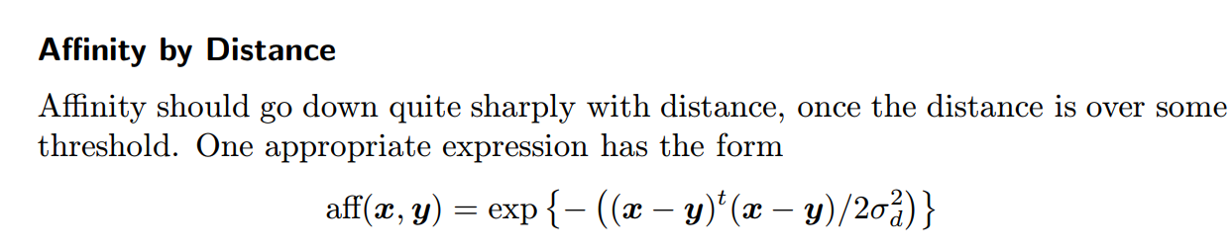
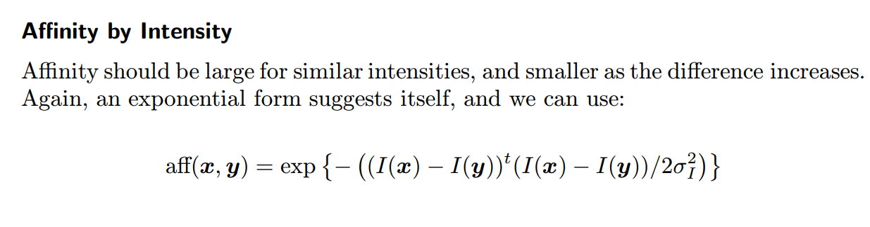
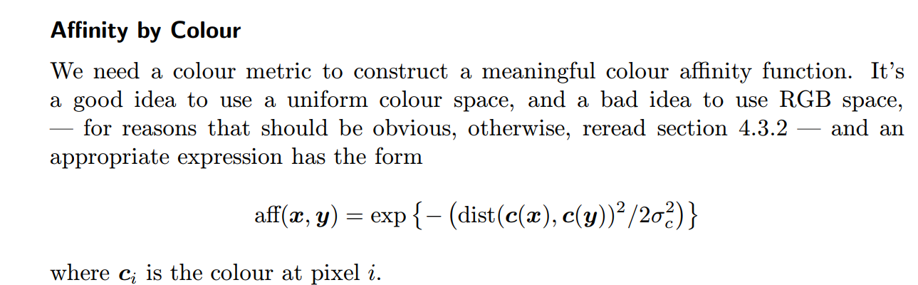
Affinity by Texture

Slide 69
Eigenvectors and Segmentation
assume that there are k elements and k clusters. We can represent a cluster by a vector with k components.
We will allow elements to be associated with clusters using some continuous weight — we need to be a bit vague about the semantics of these weights, but the intention is that if a component in a particular vector has a small value, then it is weakly associated with the cluster, and if it has a large value, then it is strongly associated with a cluster.

Slide 70
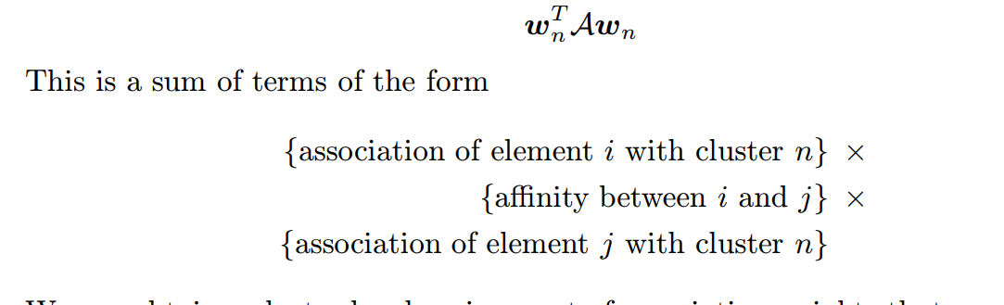
Extracting a Single Good Cluster

Slide 72
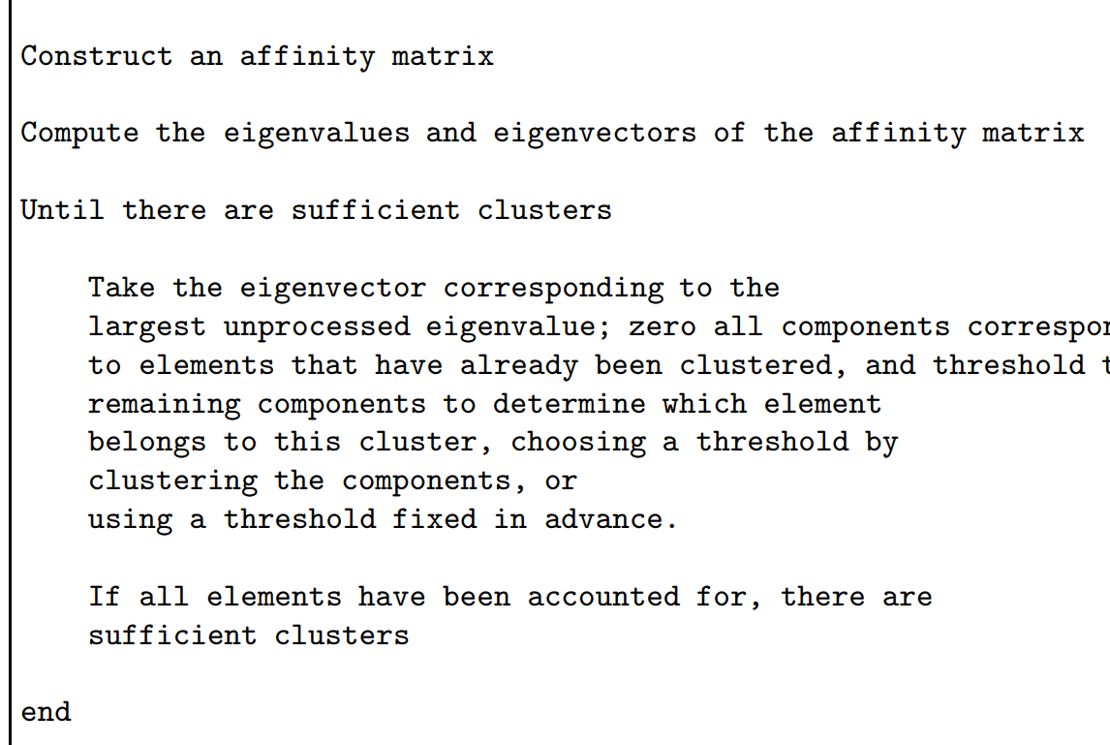
Clustering by Graph Eigenvectors

Slide 73
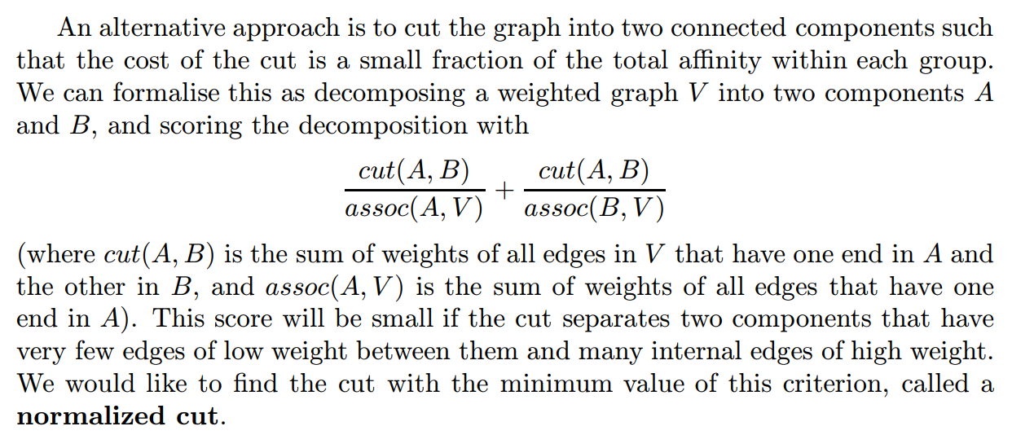
Normalised Cuts

Slide 74
Important Questions

